Slide 1
ITW 2 PROJECT
SUBMITTED BY:
Ishtmeet Singh 18075025
Madhur Sahu 18075038
Naman Garg 18075039

Slide 2
YOUR SHOP
An E-Commerce portal

Slide 3
GOALS:
To create an online platform for purchasing of different category of products.
To create a user friendly website where he/she can add product to cart, and manage his or her own account.

Slide 4
FRAMEWORKS USED:
Back-end is written in Django.
Front end is written in HTML.
Styling is done using Bootstrap, CSS and JavaScript.
Forms are created using Django.

Slide 5
PAGE STRUCTURES AND SITE DESIGN

Slide 6
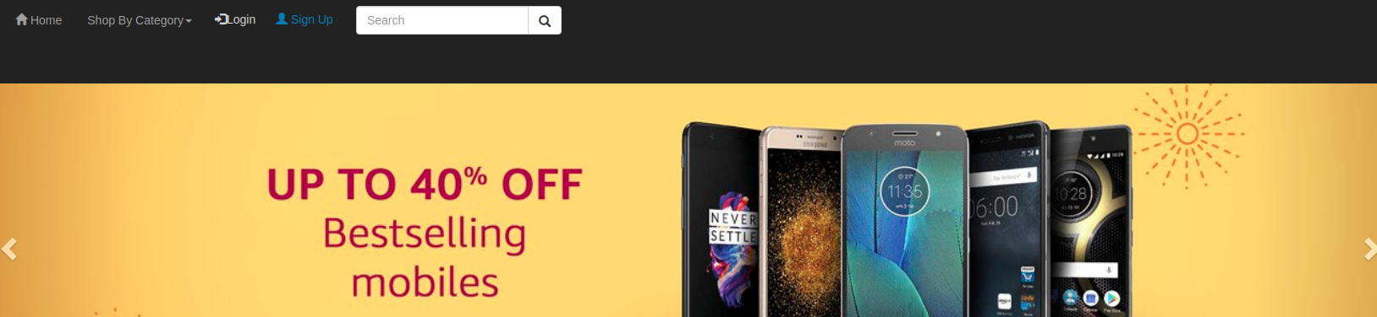
header
Header is created using Bootstrap and CSS.
Header is included in all pages of the website using Jinja Templating.
Header contains buttons for login, signup, search and category of products when user is not logged in.

Slide 7
After login header contains link to cart and logout. Everything else remains same.
Using shop by category button in header, we can view products of different categories available.

Slide 8

HOMEPAGE
Home page contains the header which is included in homepage.html template.
A carousel is there just below the header which shows different products and sales on website. This is used for advertising purposes also.
After that all the products on website are listed with their price and images in respective tiles.

Slide 9
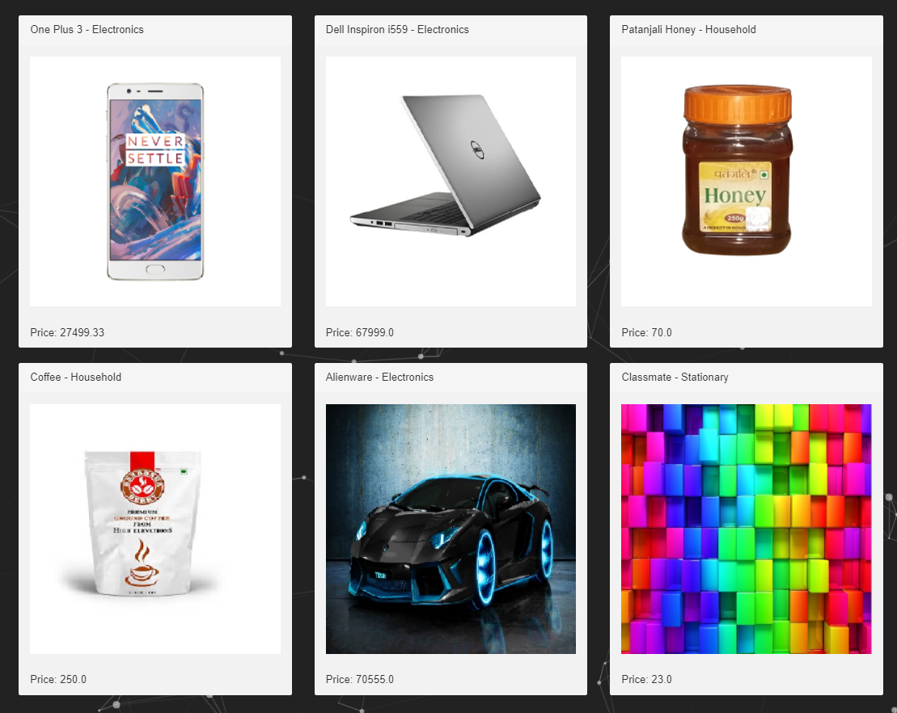

Slide 10
LOGIN & SIGNUP
The login is implemented as a dropdown box using Bootstrap and JS.
By clicking on sign-up we are directed to signup page in which personal details for creating an account are recorded using a Django form.

Slide 11
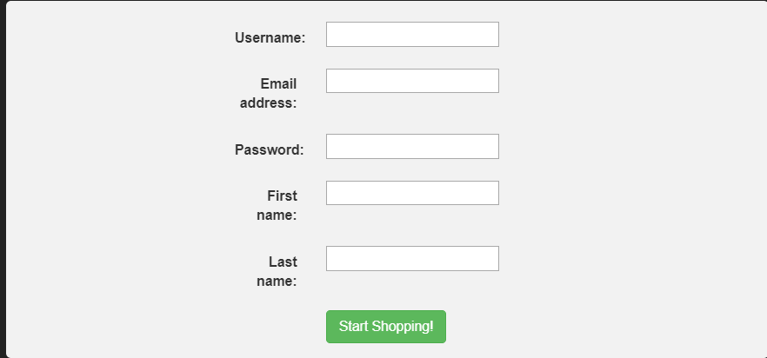

Slide 12
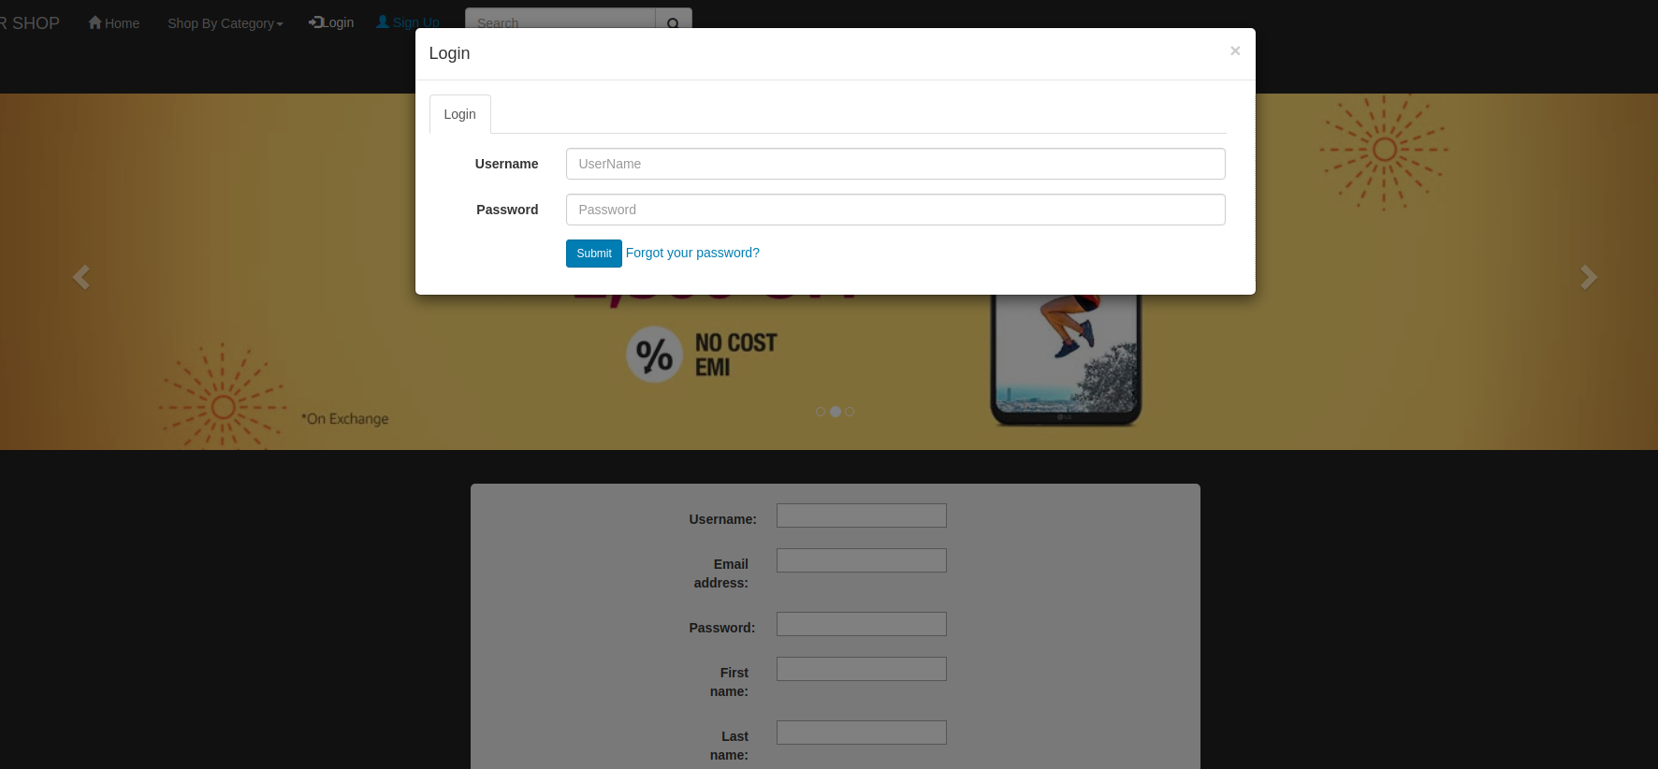

Slide 13
ACCOUNT
After sign up, an account is created for the user where he can search the website, it’s products and different categories.
We can add different number of products to cart after creating an account. We have coded the cart in such a way that it is only accessible after signup and login.

Slide 14
DETAILS PAGE
This page contains the details of the product we’ve opened, viz. it’s price, rating, type, description etc.
It contains the button for adding to cart, go to cart, and back to homepage.

Slide 15
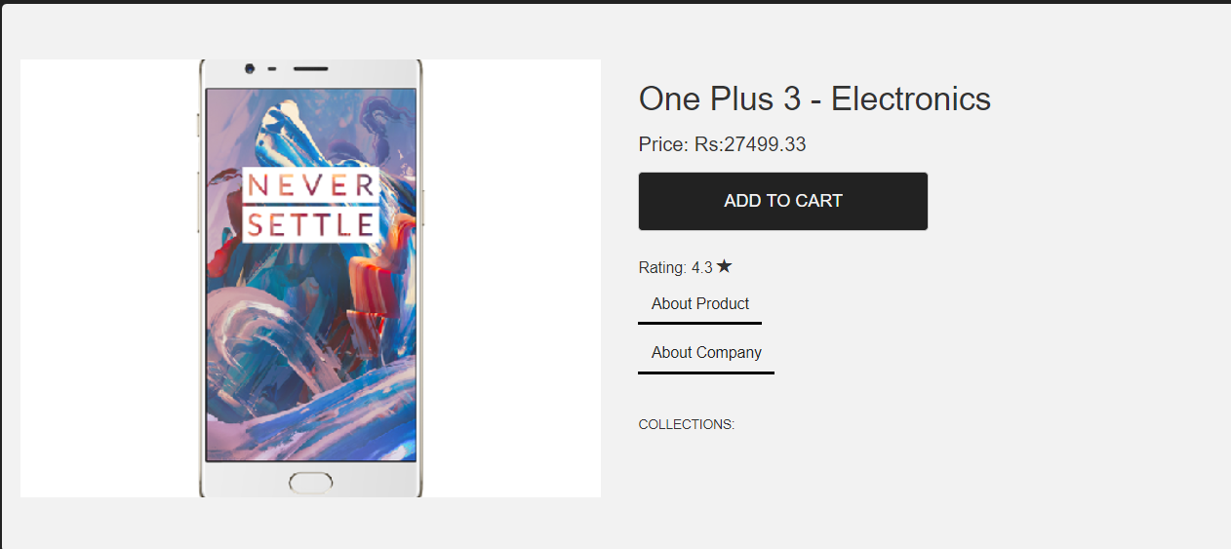

Slide 16
CART
Cart contains the products that are added by the user.
A proceed to checkout button is added which sends user to a delivery page.
You can even surf the website after adding products into cart.
Cart is editable, that is you can add and delete from cart page.

Slide 17
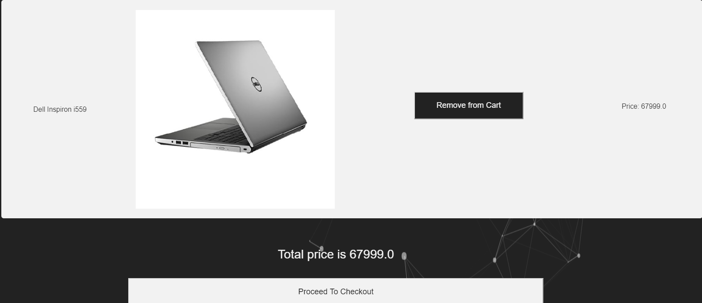

Slide 18
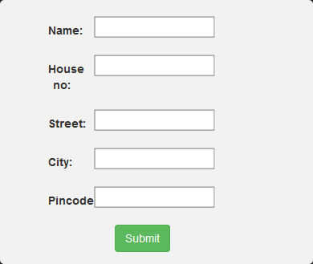
Checkout page
Checkout page is a django form which contains fields like name, address, pin code etc.
A Submit button is there which will record the delivery details and a thank you text is displayed.

Slide 19
THANK YOU

